Slide 1
Games as Information Systems
Geraldo Xexéo^{1,2}, Eduardo Mangeli¹, Farmy Silva¹, Leandro Ouriques^{1,3}, Luis Felipe Coimbra Costa¹ and Rafael Studart Monclar¹
1 Programa de Engenharia de Sistemas e Computação, COPPE/UFRJ, Brazil 2 Departamento de Ciência da Computação, IM/UFRJ, Brazil 3 Center for Naval Systems Analyses (CASNAV), Brazilian Navy

Slide 2

LUDES
Ludology, Engineering and Simulation
LUDES is a laboratory created to research Games and Simulations with the tools of Engineering, aiming to understand:
What is a game
Why people play games
What is quality for games
How to develop games
What are the impacts of games
http://ludes.cos.ufrj.br

Slide 3
Summary
Introduction
What are Information Systems?
Theories from Games Studies
Defining Games as IS
Examples
Using IS in Game Design
Conclusion

Slide 4
Introduction

Slide 5
Motivation
Game design and development turned out to be a legitimate profession and industry.
There are undergraduate and graduate courses in Game Design, Art, Programming and all others related to this subject.
New knowledge is being defined by borrowing from other areas such as administration, management, art, narrative studies by creating new models, tools and practices both from empirical evidence and scientific investigation.
Game industry has been using many elements from Information Systems (IS), but without any formal or theoretical approach.

Slide 6
Problem
There is not yet a set of widely accepted standard of practices for game conception, development, maintenance and study (Aleem, 2016) (O’Hagan2014)
Information System techniques may help game development to achieve maintainability, flexibility, lower effort and cost, and better design.

Slide 7
What are Informaition Systems?

Slide 8
What is a System?
Set of interrelated components that function together in a meaningful way (Davis e Yen,1988), in which the whole system is greater than the sum of its components, since new properties emerge from the actions and interactions among them.
These properties do not exist in the parts when isolated (Bunge, 1979)

Slide 9
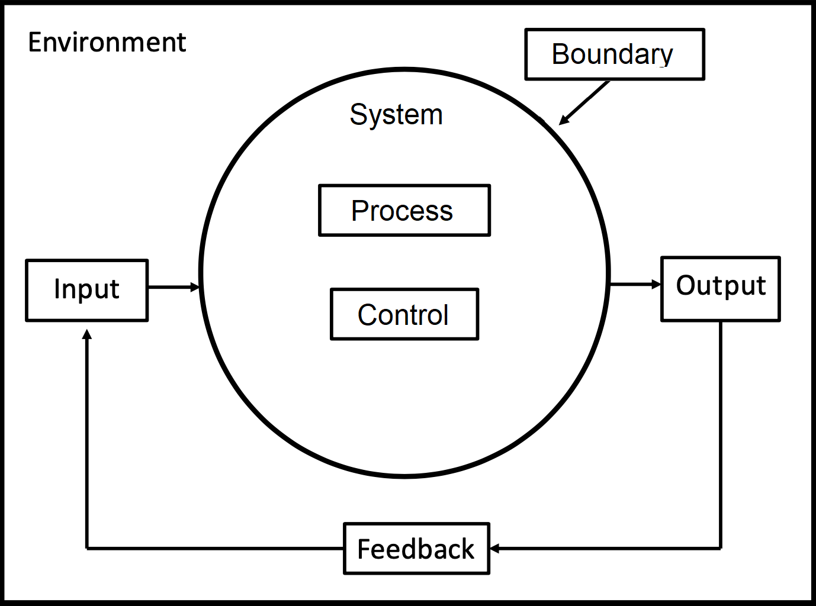

Information Systems
Arrangement of people, data, processes, and information technology that interact to collect, process, store, and provide as output the information needed to support an organization (Whitten and Bentley, 2007)
(Davis e Yen,1988)

Slide 10
Theories From Game Studies

Slide 11
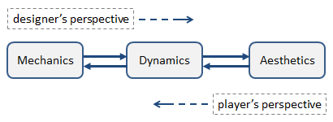
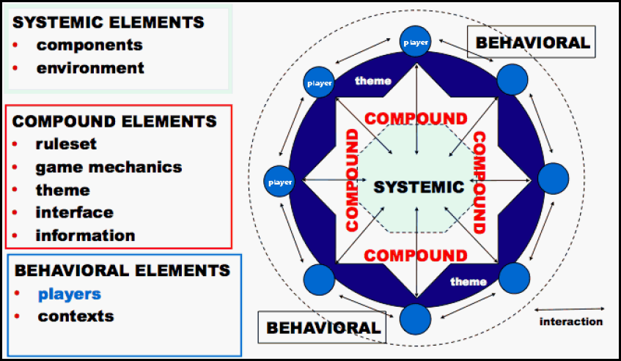
Theories from Game Studies
MDA framework
Järvinen Elements
Classical Game Theory
Procedural Rethorics

Slide 12
Defining Games as Information Systems

Slide 13
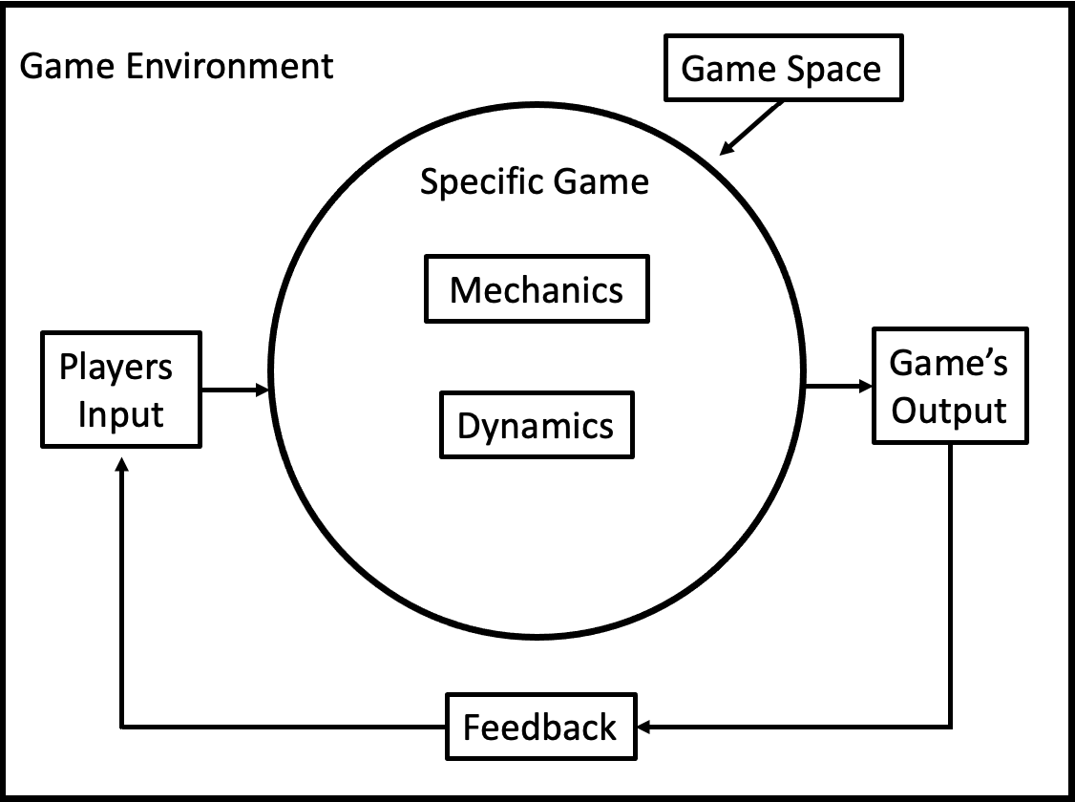
Conceptual Model

Slide 14
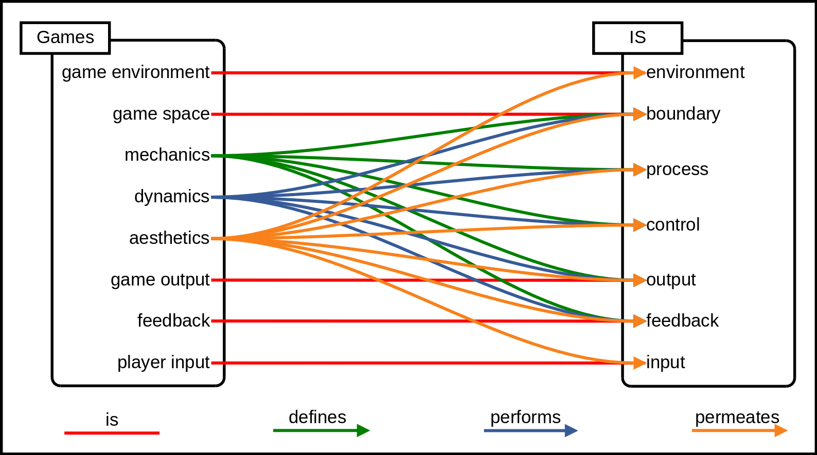
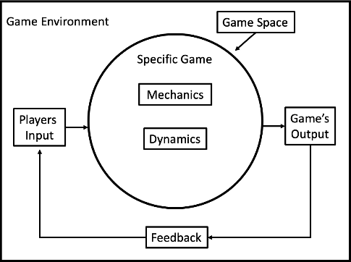
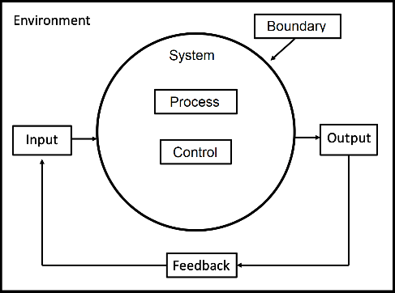
Mapping of Elements

Slide 15
Examples

Slide 16
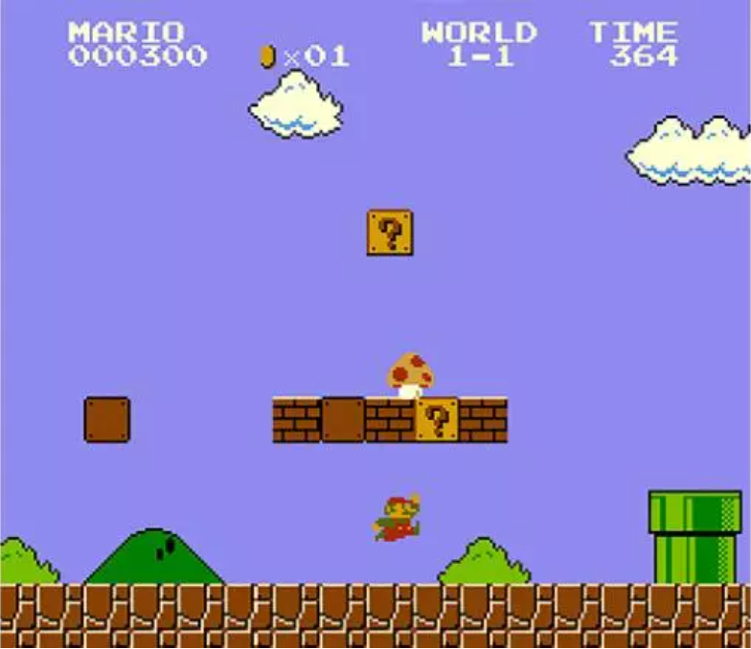
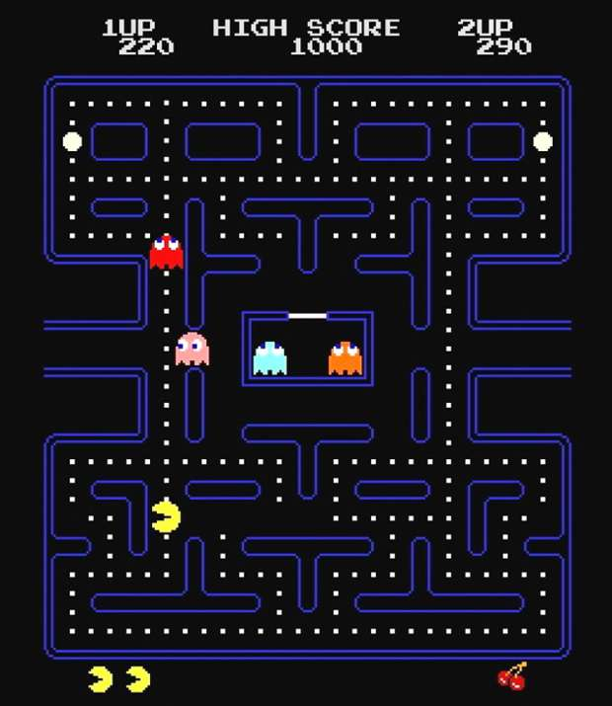
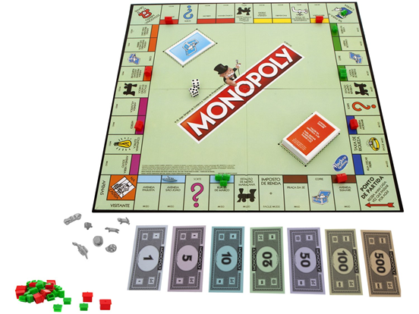
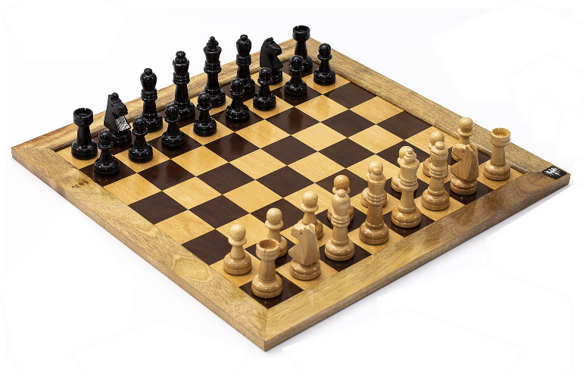
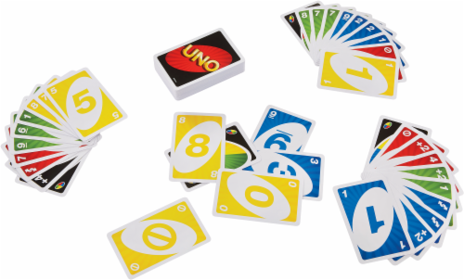
Modelling Games - Examples
Video Games
Board Games
Card Game

Slide 17
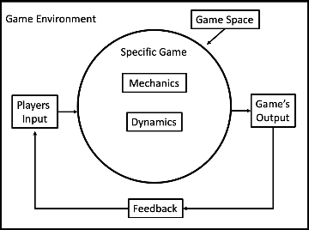
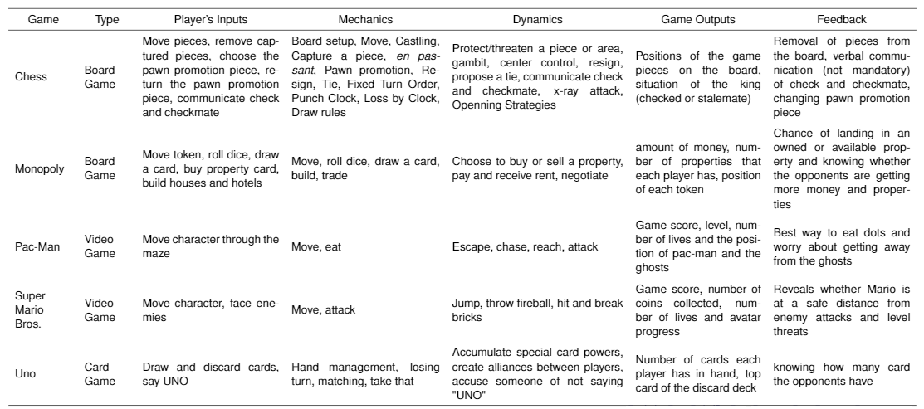
Analysis Results

Slide 18
Using IS in Game Design

Slide 19
Tools and Methodologies
Method for mapping the elements of business process models using BPMN (Classe, 2018)
Software Product Line architecture was proposed to support the design of educational games (Martins, 2018)
UML diagrams to represent game elements: characters, scenarios, actions and so on; and model games as finite state machines (Tang, 2008) (De Lope and Medina, 2016)
Formal Framework - Machinations - to represent discrete game mechanics, which was inspired by the Petri Nets (Dormans, 2012)

Slide 20
Quality
Fundamental aspect in the game design process
ISO/IEC 25010:2011 standard describes a quality model for systems and software that can be applied to games
Qualinet model for Quality of Experience (QoE) were used to build a taxonomy of factors, aspects, and features that are relevant to games (Möller, 2013)

Slide 21
Conclusion

Slide 22
Contributions
Two conceptual models:
First model presents game components, which was extended from a conceptual model of systems
Second model correlates the IS concepts with game elements from theoretical models of games, for instance, the MDA Framework
Paper can guide future works that lead towards a better understanding of the game design process and the emerging game engineering

Slide 23
Future Work
Build a practical framework for analyzing games as IS
Continue investigating recognized techniques in IS to incorporate them into the game designs developed by our research group

Slide 24
Obrigado!

Slide 25

References
Saiqa Aleem, Luiz Fernando Capretz, and Faheem Ahmed. 2016. Game development software engineering process life cycle: a systematic review. Journal of Software Engineering Research and Development 4, 1 (nov 2016), 30. https: //doi.org/10.1186/s40411-016-0032-7
Mario Bunge. 1979. Treatise on Basic Philosophy - Ontology II: A World of Systems. Treatise on Basic Philosophy, Vol. 4. Springer
Tadeu Classe, Renata Araujo, and Geraldo Xexéo. 2018. De Processos de Negócio para Jogos Digitais: Uma Proposta de Mapeamento. In Anais do XIV Simpósio Brasileiro de Sistemas de Informação. Sociedade Brasileira de Computação (SBC), RJ, Brazil, 465–472
Willian S. Davis and David C. Yen (Eds.). 1998.The Information System Consultant’s Handbook: Systems Analysis and Design(1st ed.). CRC Press
R. P. De Lope and N. Medina-Medina. 2016. Using UML to Model Educational Games. In2016 8th International Conference on Games and Virtual Worlds for Serious Applications (VS-GAMES). IEEE, Barcelona, Spain, 1– 4. https://doi.org/10.1109/VS-GAMES.2016.7590373
Joris Dormans et al.2012.Engineering emergence: applied theory for game design. Universiteit van Amsterdam, Netherlands
Gevã Martins, Welington Silva, Fernanda Campos, Victor Stroele, José Maria N. David, and Regina Braga. 2018. Construção de Jogos Educacionais através de Modelo de recursos. In Anais do XIV Simpósio Brasileiro de Sistemas de Informação. Sociedade Brasileira de Computação (SBC), 16–22.
S. Moller, S. Schmidt, and J. Beyer. 2013. Gaming taxonomy: An overview of concepts and evaluation methods for computer gaming QoE. In 2013 Fifth International Workshop on Quality of Multimedia Experience (QoMEX). IEEE, Klagenfurt am Wörthersee, Austria, 236–241. https://doi.org/10.1109/QoMEX.2013.6603243
Ann Osborne O’Hagan, Gerry Coleman, and Rory V. O’Connor. 2014. Software Development Processes for Games: A Systematic Literature Review. In Communications in Computer and Information Science. Springer Berlin, 182–193. https://doi.org/10.1007/978-3-662-43896-1_16
Stephen Tang, Martin Hanneghan, Tony Hughes, C Dennett, S Cooper, M Ariff Sabri, et al. 2008. Towards a domain specific modelling language for serious gam design. In 6th International Game Design and Technology Workshop. Liverpool John Moores University, Liverpool, UK, 10 pages
Jeffrey Whitten and Lonnie Bentley. 2007. System Analysis and Design Methods (7th ed). McGraw-Hill.

Slide 26
Acknoledgments
This study was supported by
the Conselho Nacional de Desenvolvimento Científico e Tecnológico (CNPq) - Brasil under Grant RESOLUÇÃO NORMATIVA RN-017/2006
Coordenação de Aperfeiçoamento de Pessoal de Nível Superior (CAPES) - Brasil under Grant Finance Code 001.
Farmy Silva was supported by CNPq.
Leandro Ouriques was supported by Brazilian Navy.
Eduardo Mangeli and Luis Coimbra were supported by CAPES.

Slide 27




Saiba mais sobre nosso trabalho
http://ludes.cos.ufrj.br

